Slide 1
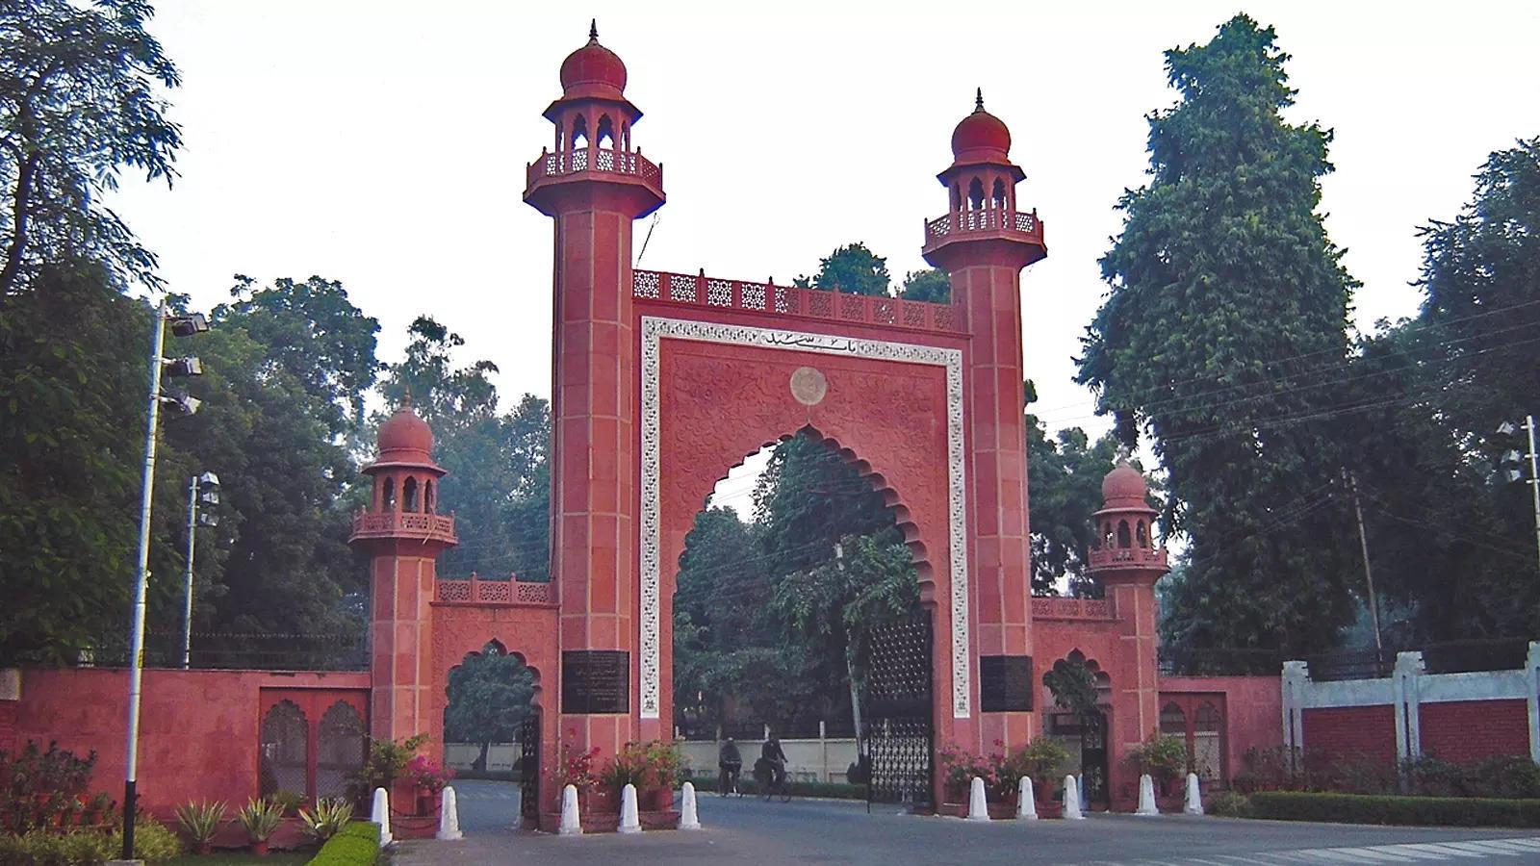

Aligarh Muslim University
ANNUAL MAGAZINE
2024-25

